Slide 1

Online Beauty and Skincare Shop
Guided by:-
Dr.Ruchita Shah

Slide 2
Agenda
Introduction
Existing System
Need for New System
Scope of New Project
Flowchart
Objective of New Project
. ER Diagram
Use Case Diagram
DFD Diagram
Presentation Title

Slide 3

Introduction
If customers like our beauty and skincare products, they can place an order and make payments online. After payment, they will receive an order confirmation code, which confirms their purchase. The admin can add new products, update details, or remove products from the store. Customers can view product information, leave reviews, and cancel orders if needed.

Slide 4

Currently, beauty and skincare products are mostly purchased offline. Customers have to visit a physical store, browse the available products, consult with staff, and then make a purchase. The availability of products depends on store timing, and sometimes staff are not available to assist, which can cause inconvenience and delays.
Existing System

Slide 5


Need for New System
The current offline process consumes a lot of time and resources. Customers have to travel to the store and wait in line. If the desired product is out of stock, they might leave disappointed, which results in a loss of potential sales. To solve these issues, an online system is necessary where customers can view, purchase, and receive products from the comfort of their home.

Slide 6

Objective of New Project
Customers can visit the website to explore beauty and skincare products. They can view product images, read detailed descriptions, filter by category, and place orders. The system allows product search, reviews, ratings, and the ability to cancel orders. Customers can also learn about skincare tips and routines. The admin manages product listings and order tracking.

Slide 7

Need for New System
This website is for a single beauty and skincare brand/store located in Ahmedabad. It works online, so internet access and a browser are required. To purchase products, users must register and log in. The system supports secure online payments and provides tracking information.

Slide 8
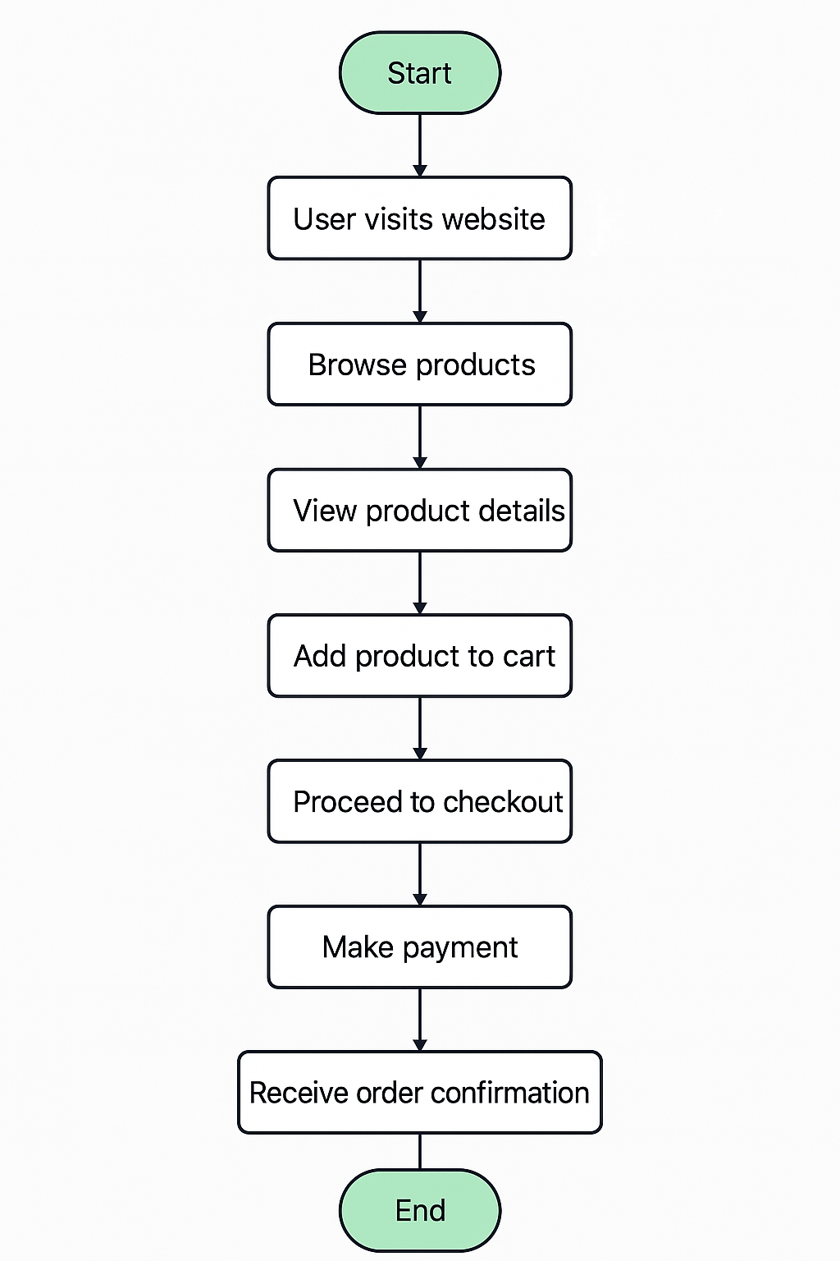
Flow chart of new system

Slide 9
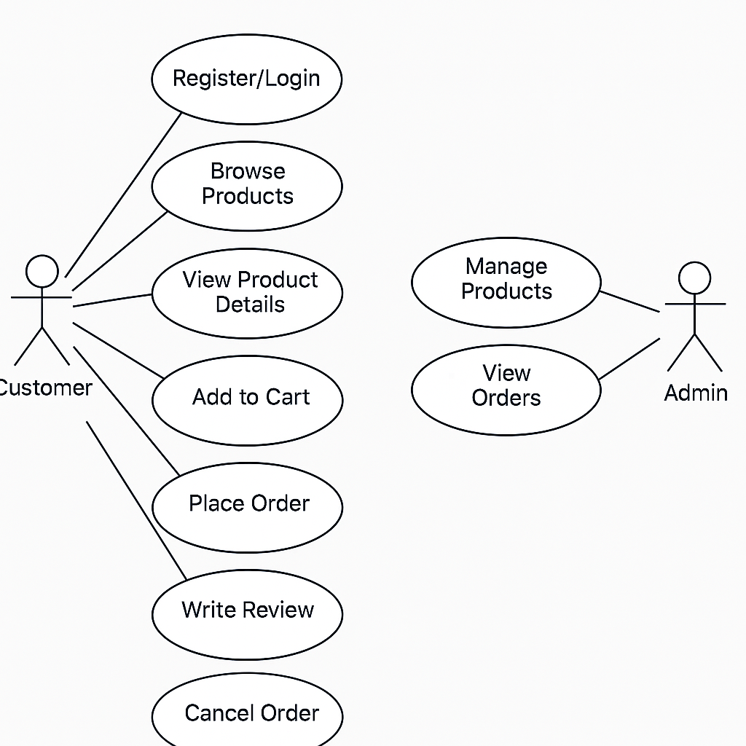
Use case Diagram

Slide 10
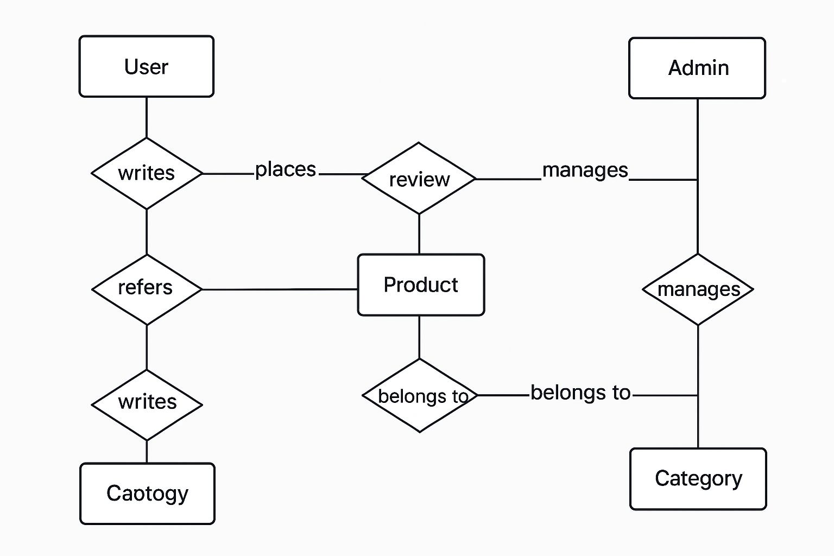
E-r
Diagram

Slide 11
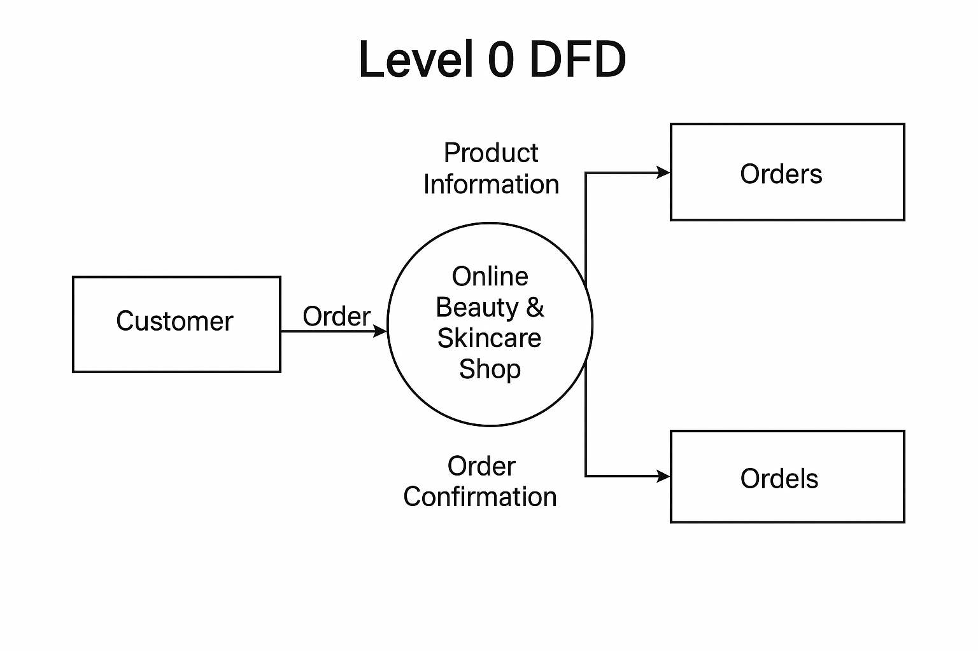
DFD
(0 level)Diagram

Slide 12
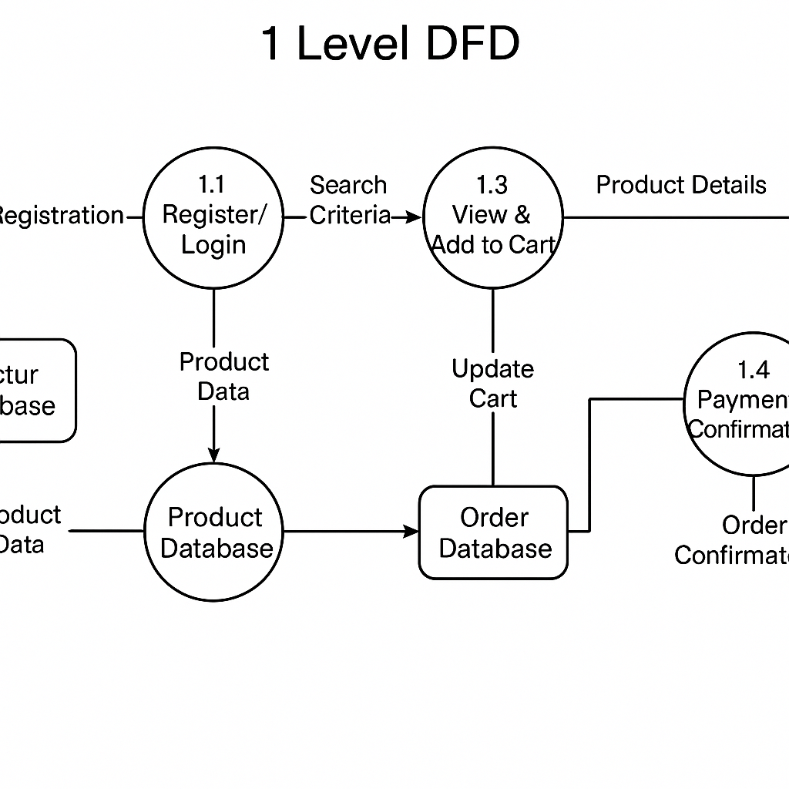
DFD
(1 level)Diagram

Slide 13
Data Dictionary
Customer Stores user information like name, email, password, and address for login and order processing.
Product Contains product details including name, price, description, stock, and category.
Cart Holds products temporarily added by customers before placing an order.
Order Records customer orders with date, total amount, and current status.
OrderDetails Lists individual products and quantities within a specific order.
Payment Stores payment info such as amount, method, and payment status.
Review Captures customer ratings and feedback for purchased products.

Slide 14
Thank You
Represented by:-
Sneha Solanki-240160510048

